Slide 1


Stock Inspector Consulting
San Francisco I New York I Shanghai I London I São Paulo
July 11th, 2020

Slide 2





Our SF team
James Ye
CEO / Co-Founder
Tanvir Khan
CTO / Co-Founder
Nicky Pant
Financial Advisor
Paul Pineda
CIO
Fabienne Zumbühl
CDO
“I love combining the rationality of coding with the emotions of financial markets”
“I want to encourage more women to invest”
“I love when stocks hit the moon and I see my clients happy”
“Educating customers on investments opportunities is my passion”
“The excitement of collecting data keeps me awake at night”

Slide 3
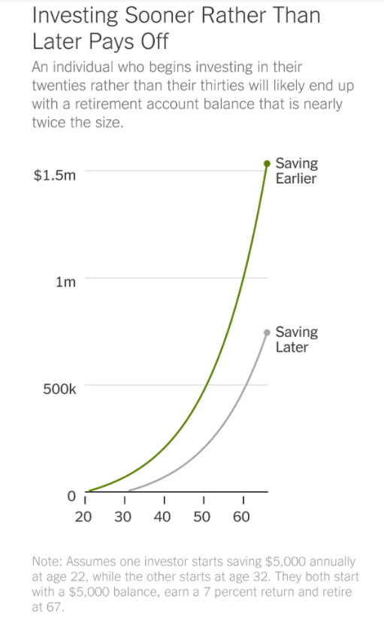

Our Mission Statement
“Make investments more accessible and easier”
Source: New York Times (2020)
Notes:
Our Mission is that we want to make investing more accessible for people. A article of the NYT from 2020 states that when investing earlier, in the 20ies, people are more likely to end up with a higher retirement.

Slide 4

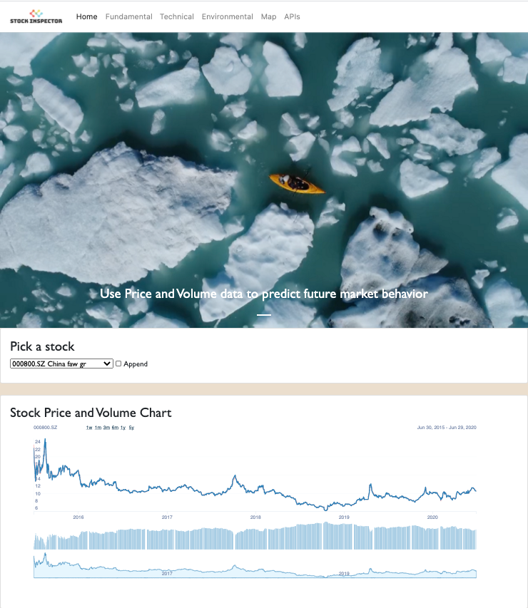
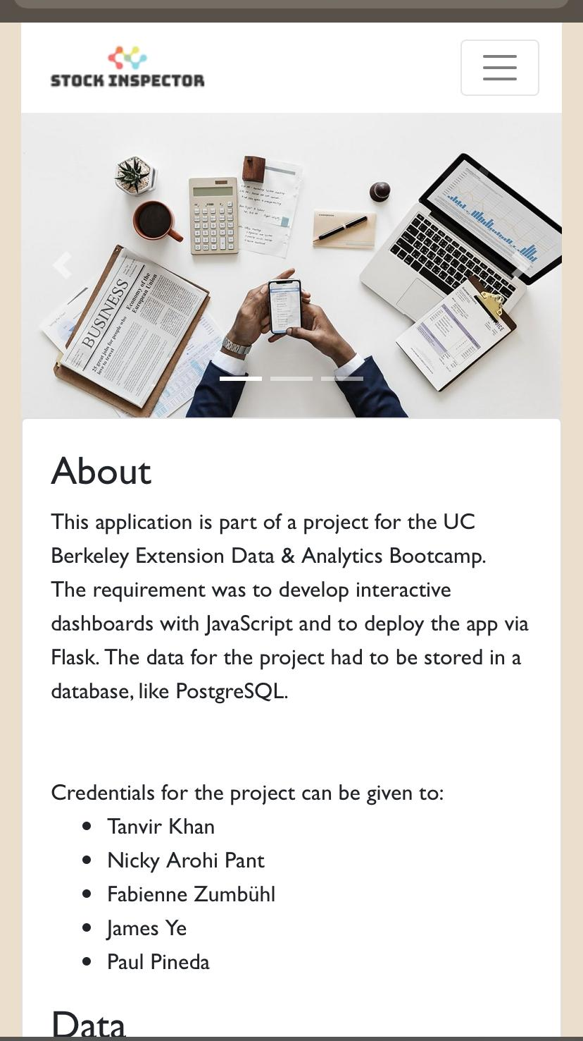
Investing in stocks has never been so simple.
In order to solve investment decision problems that most young investors face, we developed the Stock Inspector® application.
The stock inspector application provides you with fundamental, technical and environmental data on the top Global Fortune 171 companies.
Our Version 1.0
For Mobile and Desktop
Notes:
We want to present our Stock Inspector Version 1.0 which is works on the Desktop and on the Mobile Phone
.

Slide 5
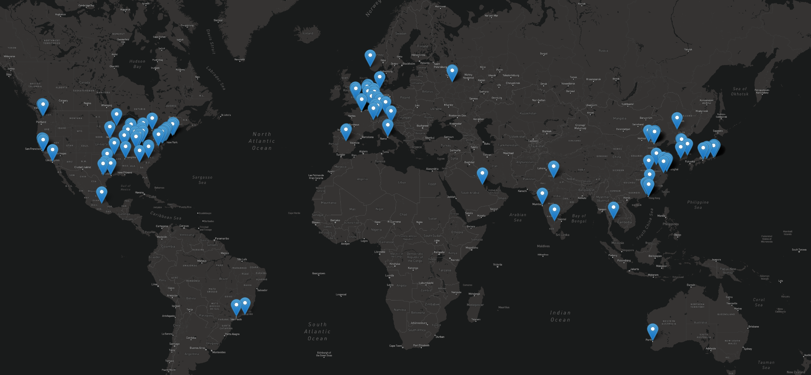

Our Global Portfolio
Notes:
Mention that we took the top 172 Comanies from the Fortune 500. They use market cap to rank the companies. We took the companies that provided enough data on Yahoo Finance.

Slide 6
Let’s check it out!
https://stock-inspector.herokuapp.com/
Notes:
mention a bit the tools we used: external library → data tables

Slide 7

Fundamental Stock Data

Slide 8
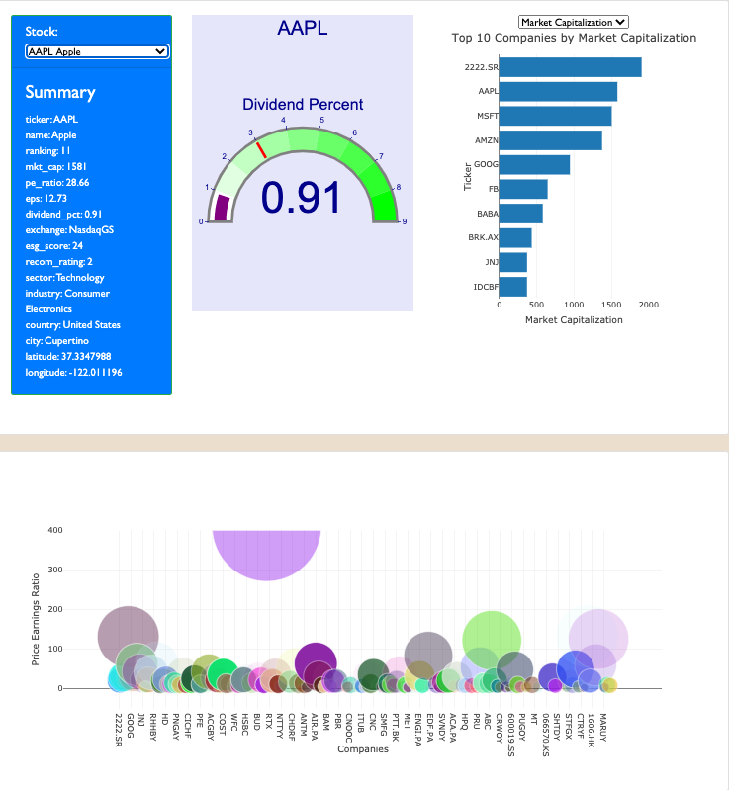
Fundamental Graphs
Summary Graph
Dividend Percent Gauge
Provides an overall summery
on the companies
Provides an overview on the dividend percent emitted to stockholders
Top 10 Companies
Reach your dream
for Market Capitalization
for Dividend Percent
for Price per Earnings (is inverted, meaning the lower the better)
Relative visualization of companies and their price earnings ratio

Slide 9

Technical Stock Data

Slide 10
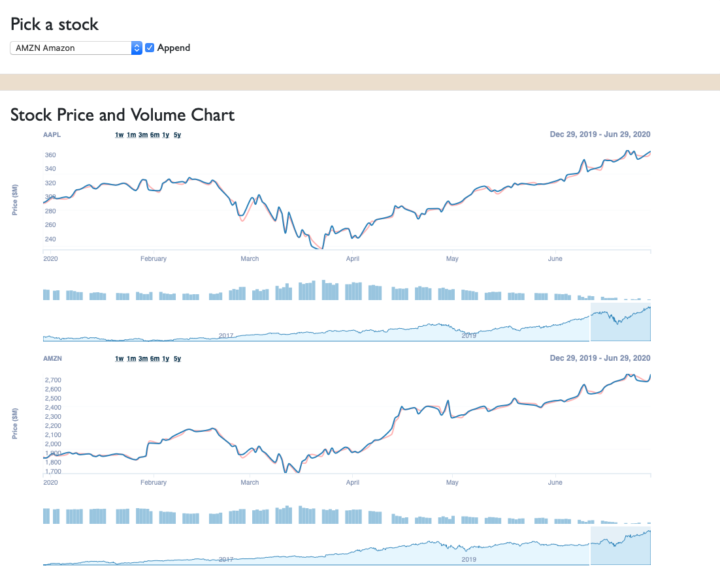
Technical Graphs
Price Graph
user friendly price graphs that provide information on:
closing prices (blue line)
average prices (red line)
volume of stocks bought
market trend
Example: After March 2020, prices dropped for Apple and Amazon. When the prices dropped, the volume of the stocks bought increased because people believed in the prices going up again. Which they did. Amazon recovered even faster than Apple.
price change
volume change
slide bar to inspect a specific time frame

Slide 11

Environmental
Stock Data

Slide 12
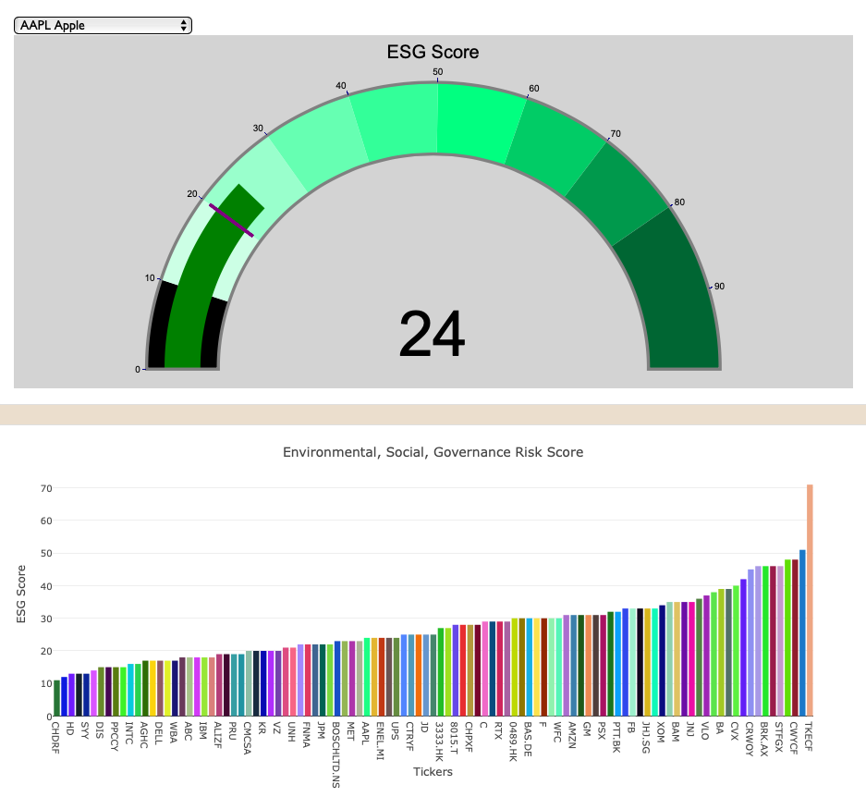
Environmental Graphs
Gauge Graph
Interactive Visualization on the ESG Score of a company:
How does a company minimizes industry specific ESG risks
ESG score from 0 to 100 (Sustainanalytics methodology)
The ESG score is a combination of the E, the S and the G score
Example: Apple has a ESG score of 24
Bar Graph
Interactive Visualization on the relative ESG score:
Holistic view on all the companies
Sorted in ascending order
Lowest score: Christian Dior (11)
Highest score: Tokyo Electric Power (71)

Slide 13
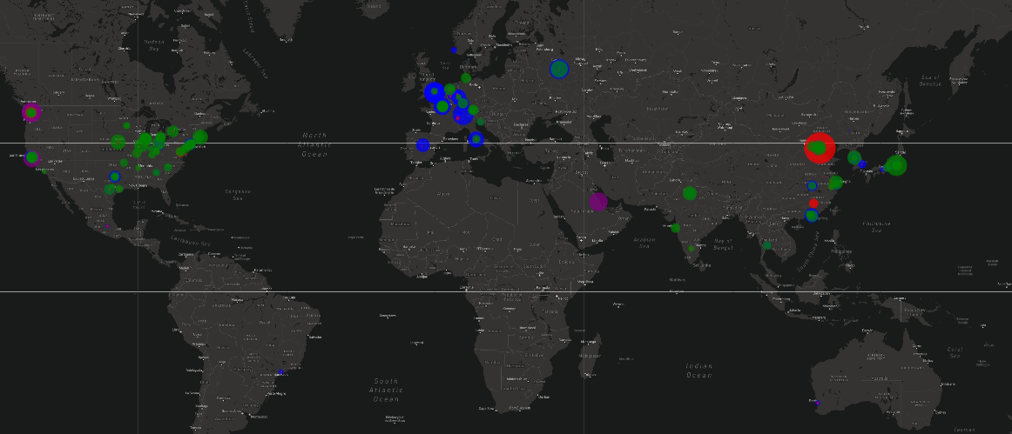
Overall Portfolio Representation
Diversified stock portfolio
We provide opportunities for risk averse and risk taking investors
Blue Circles: Dividend Payment - Most steady in Europe
Red Circles: Price per Earnings - highest ratio for JD.com in China
Purple Circles: Market Capitalization
Green Circles: ESG Rating

Slide 14














Our coding approach
Back-End
Python
PostgreSQL
SQLAlchemy
Flask
Heroku
Front-End
JavaScript Libraries
HTML/CSS & Bootstrap
JavaScript
Plotly, D3, Leaflet, jQuery
New Library: Datatables

Slide 15
Conclusion
On Groupwork
Utilizing every team members strength in a group project leads to knowledge exchange and a good final outcome!
There are different aspects, namely fundamental, technical, and environmental considerations that have to be taken into account when investing in stocks.
Providing a diversified portfolio across e.g.industries and markets is key.
Limitations
Limited Data on ESG score, P/E ratio & Dividend Percent
More data was available on US based companies - might lead to bias
Outlook
Improving the mobile version of the Stock Inspector
Candlestick chart could be added
ESG score could be split up in E, S and G scores separately

Slide 16

Thanks for Investing
with us!

